Slide 1
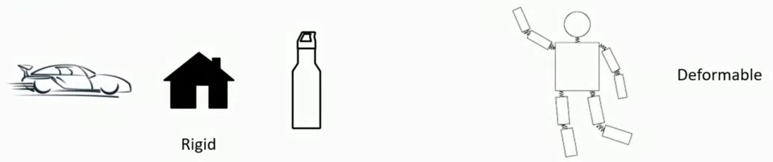
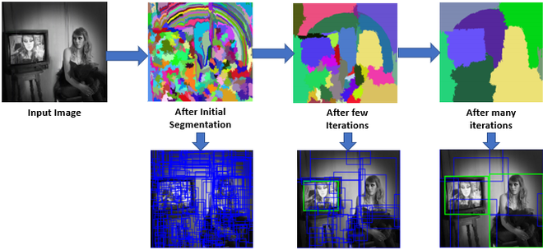
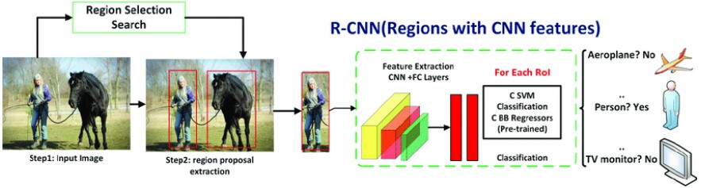
Comparison to Other Detection Systems
Deformable Parts Model (DPM): Sliding Window Method for Bounding Boxes and conventional image processing for part object detection
Region Based CNN (RCNN): Selective Search for Bounding Boxes and other machine learning steps for classification and feature extraction
Deep MultiBox: CNN used to predict bounding boxes. This is a single step in multi-class classification
Other comparisons (OverFeat, MultiGrasp): CNN localization with local perspective only, and detecting grasping regions only in single object images.

Slide 2
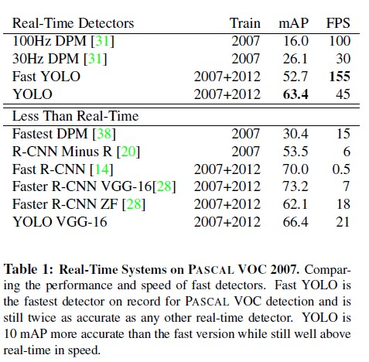
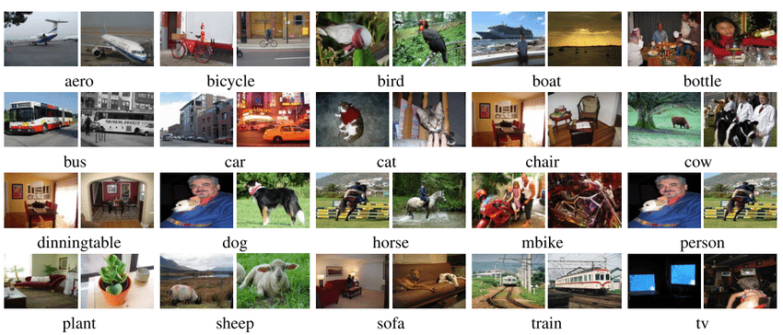
Experiments and Real-Time Performance
Pascal VOC 2007, 2012 Dataset
Different Versions of R-CNN tested

Slide 3
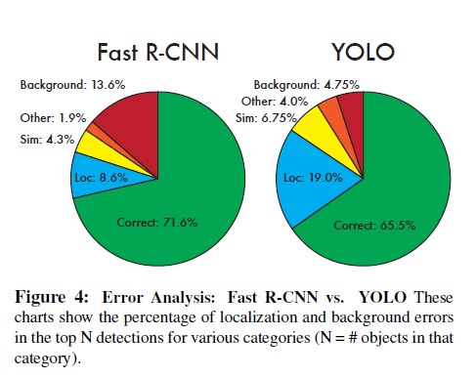
Error Analysis
Correct: class is correct, and Intersection over union (IOU) is greater than 0.5.
Localization: class is correct, and IOU is greater than 0.1 but less than 0.5.
Similar: class is similar, and IOU is greater than 0.1.
Other: class is wrong, and IOU is greater than 0.1.
Background: for all IOU less than 0.1.
Combining YOLO and Fast RCNN is beneficial: a raise from 71.6% to 75%.

Slide 4
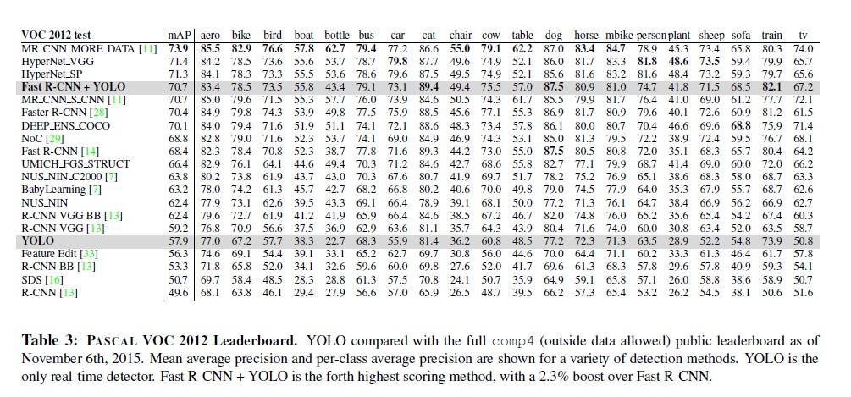
VOC 2012 Discussion (visual object classes)

Slide 5
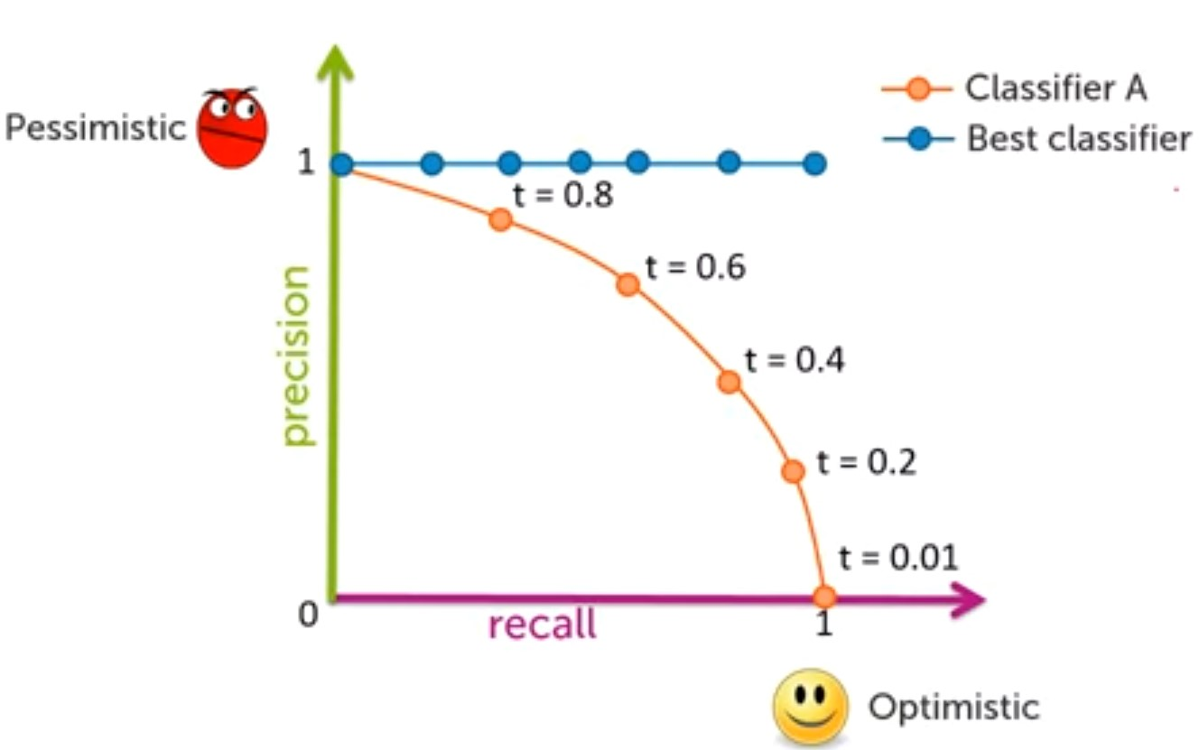
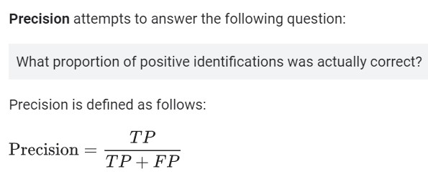
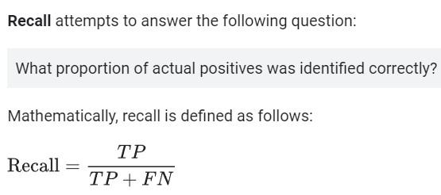
Review on Precision and Recall

Slide 6
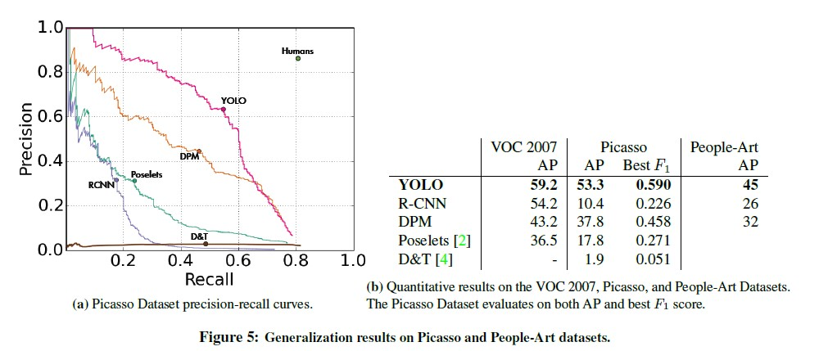
Generalizability: Person Detection in Artwork
Picasso Dataset and People-Art Dataset are used in this testing.

Slide 7
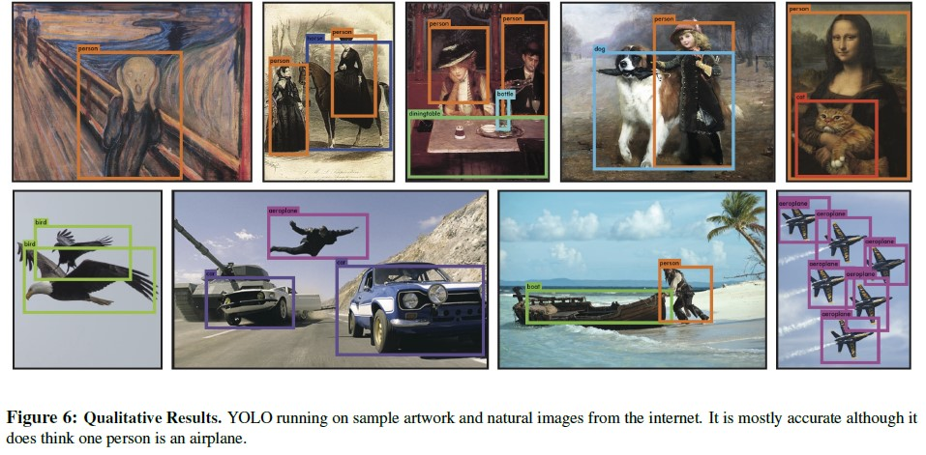
YOLO Real-time detection in the Wild

Slide 8

In Conclusion, “You Only Look Once”

Slide 9
Thank You (Made By: Hamdy Osama 2100966)
Questions?
Full Presentation will be published when all team members are ready

